Slide 1
Team 1 BEARCAT CAR POOLING

Slide 2
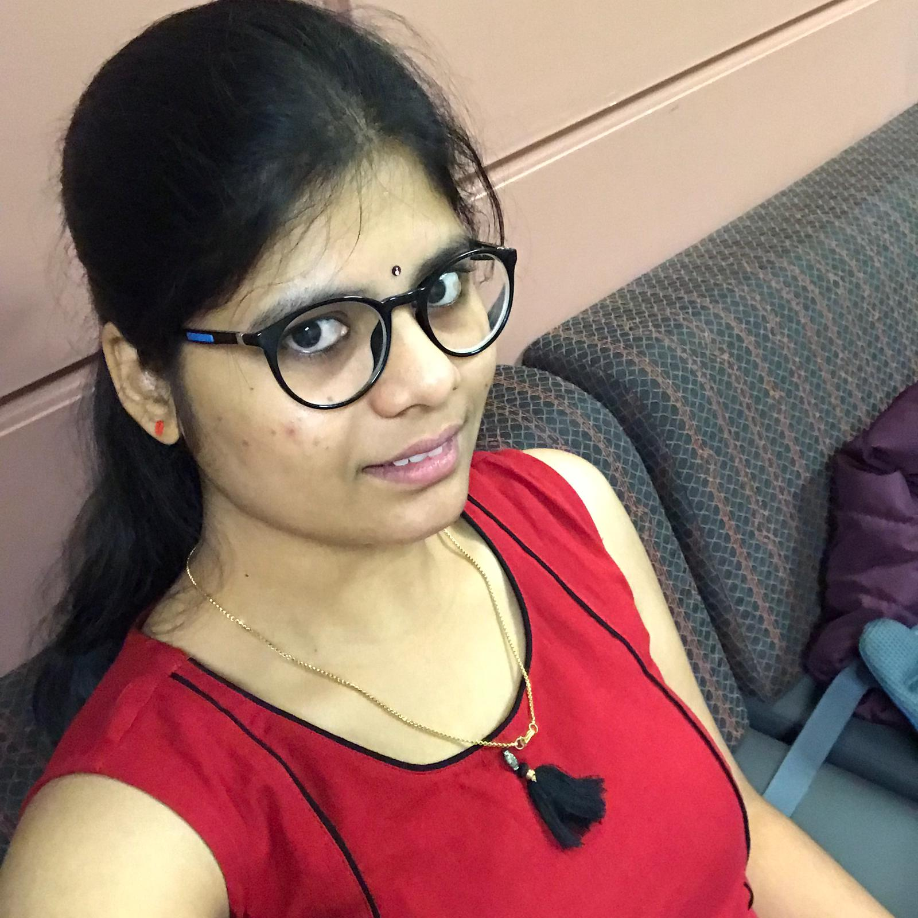
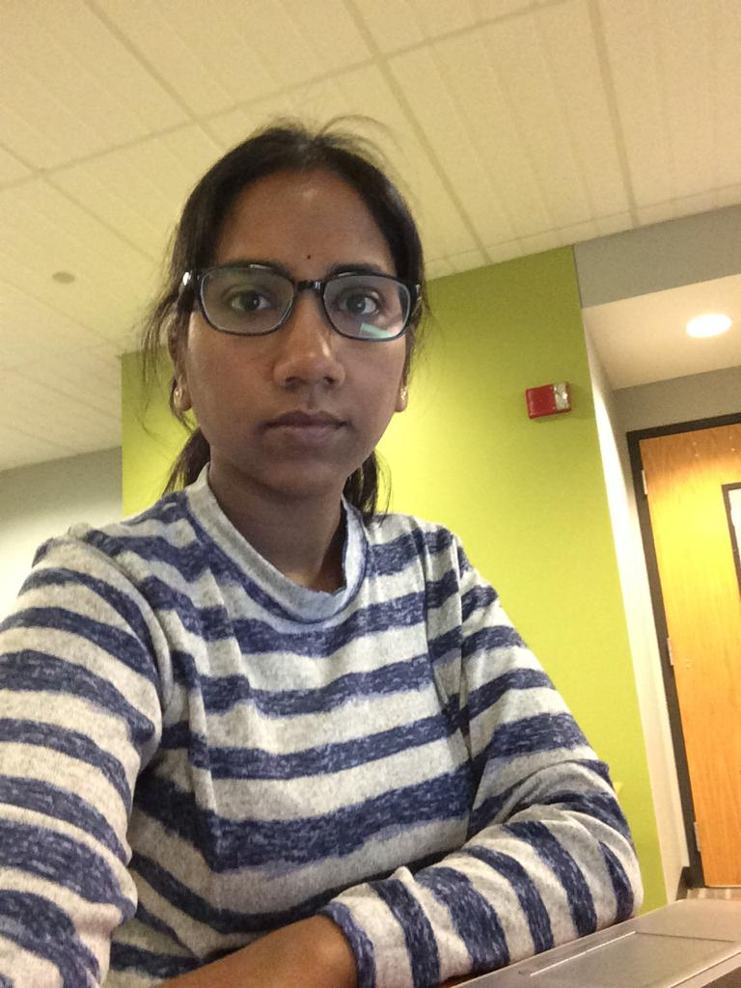

Team members
Harshitha Chetty Ragava
Harshitha Chetty Ragava
Gouthami Pasham
Vamshi Krishna Nuka

Slide 3
Introduction to the problem
Few times going to college will become quite challenging due to some reasons like heavy snow, wind or rain.
Uber Services are not quite active in Maryville.
Cannot use other cab services due to high price.
Vamshi Krishna Nuka

Slide 4
Proposed Solution
A cool Android App.
Easy to Install and easy to use.
Is it Snowy/Rainy and hard to travel- Bearcat car Pooling is here to help you.
Our idea is people will share their ride with others who are in need of a ride- The cost are low so many people will find it useful.
This action results in a mutual benefit- Acts as a bridge between users and drivers.
Vamshi Krishna Nuka

Slide 5
List of features & completion status
User login page - Sign Up and Sign In - Completed
Database to store user data - Completed
Validating data to ensure no multiple Sign-Ups for same email or mobile number - Completed
Getting GPS location and matching user locations using Google APK’s with the help of coordinates - Completed
Vamshi Krishna Nuka

Slide 6
List of features & completion status (Cont.)
An activity of getting ride confirmation and payment method - Completed.
Creation of hamburger menu option for home, user profile, logout, etc.,. - 70% Completed with overflow menu.
If possible will add a mile range of 10, 20, 30 - Not yet completed.
Feedback from riders - Completed
Vamshi Krishna Nuka

Slide 7
Activities:
Main activity
SignIn
SignUp
Maps activity
Feedback
HelpImprove
Payment
PleaseEnterFeedback
CarBooking
Confirmation
ThankYouAlert
Vamshi Krishna Nuka

Slide 8
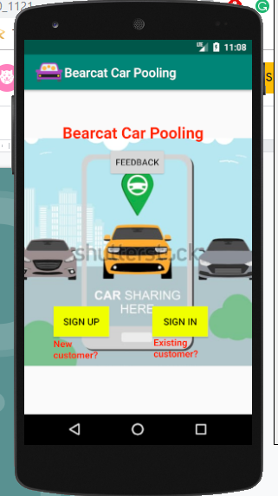
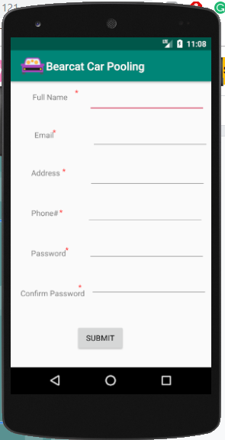
Screenshots of activities:
Vamshi Krishna Nuka

Slide 9
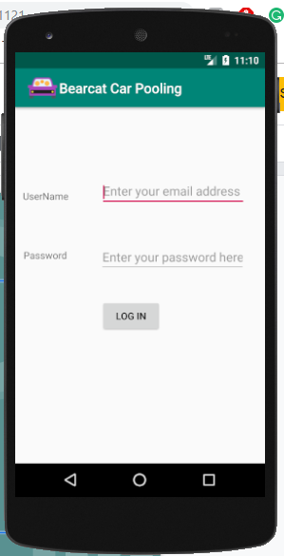
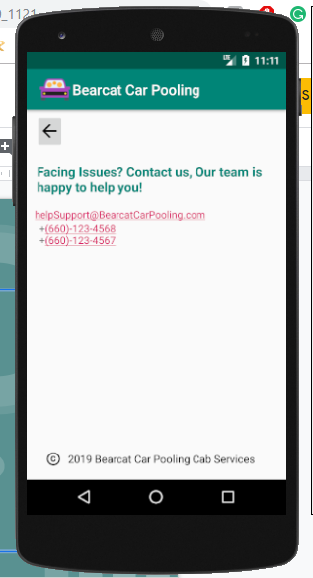
Screenshots of activities(end)
Vamshi Krishna Nuka

Slide 10
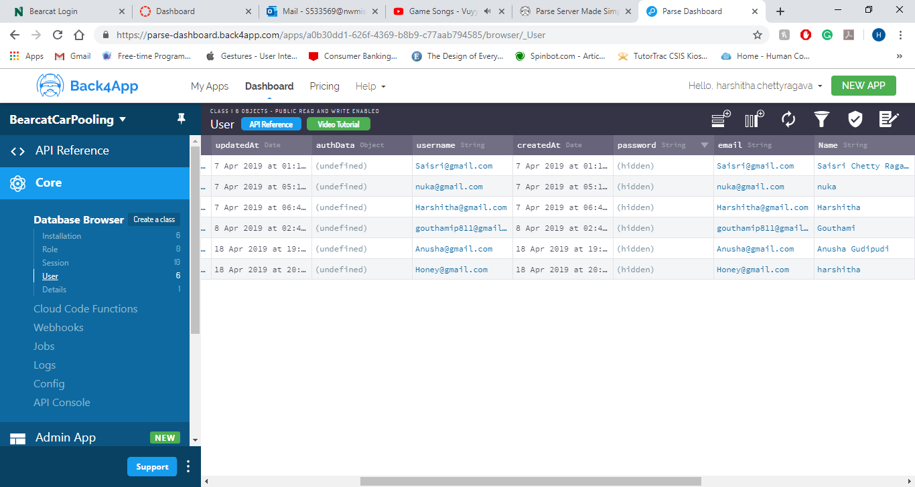
MBaas:back4app with parse
Vamshi Krishna Nuka

Slide 11
Parse User:
Subclass of Parse object.
Using parse user we can
* SignIn
* SignUp
* Logout
Vamshi Krishna Nuka

Slide 12
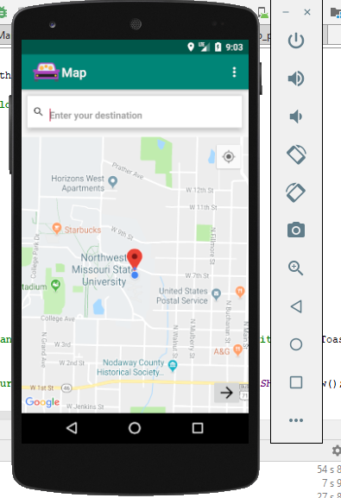
Google API: Maps
Used google’s API key for displaying the maps.
FusedLocationProviderClient - takes the responsibility to initiate and manage the connection to google play services.
Harshitha Chetty Ragava

Slide 13
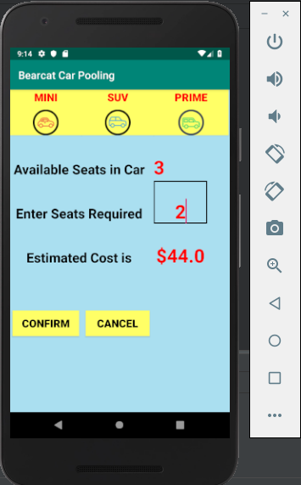
Select Your Car:
Takes location coordinates from Maps activity.
Calculates the cost.
Calculates miles.
Gives feedback
Gouthami Pasham

Slide 14
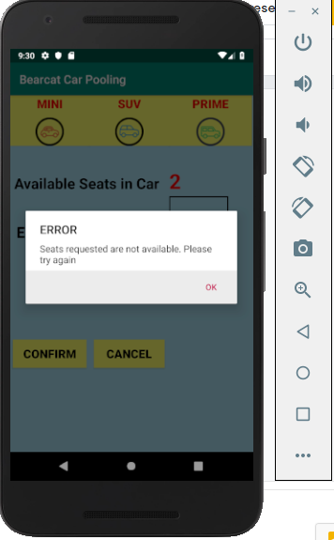
Feedback & Cost
Try to book more seats than available
Calculate cost for different cars.
Choose your ride based on estimated cost.
if (actionId == EditorInfo.IME_ACTION_SEARCH ||
actionId == EditorInfo.IME_ACTION_DONE ||
event != null &&
event.getAction() == KeyEvent.ACTION_DOWN &&
event.getKeyCode() == KeyEvent.KEYCODE_ENTER) {
if (event == null || !event.isShiftPressed())
Gouthami Pasham

Slide 15
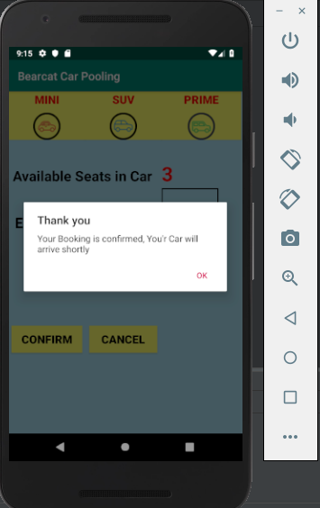
Confirm Booking
Gouthami Pasham

Slide 16
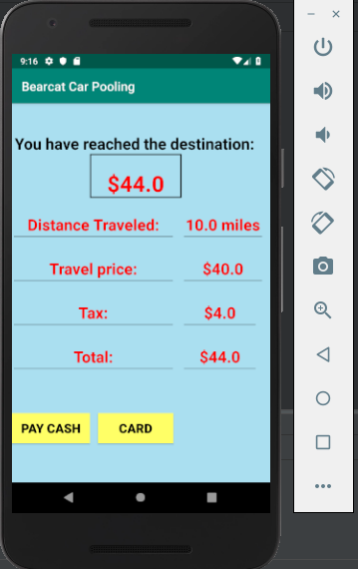
Reached Destination:
Detailed Cost.
Amount Payable on the top.
Intent intt = new Intent(this, Reached.class);
intt.putExtra("est_cost","$"+Total_cost);
intt.putExtra("Dist_Travel",no_mile+" miles");
intt.putExtra("Travel_price","$"+est_cost);
intt.putExtra("tax","$"+Tax);
intt.putExtra("Total","$"+Tax);
startActivity(intt);
Gouthami Pasham

Slide 17
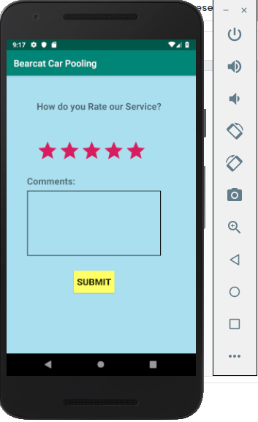
Feedback Form
Feedback helps to improve.
Click on starts.
Gouthami Pasham

Slide 18
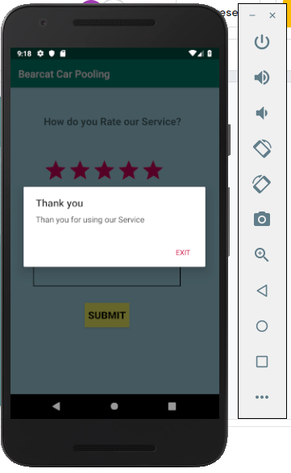
Feedback Cont..
5 Star Rating- Simple Alert box Thanking users
Gouthami Pasham

Slide 19
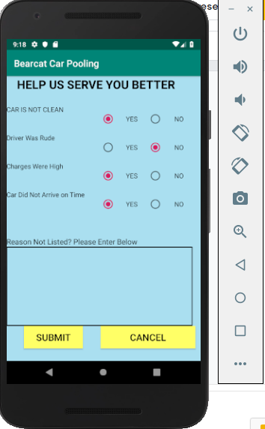
Low Rating
Additional Feedback.
Improves Business.
Helps making decisions.
Gouthami Pasham

Slide 20
Challenges faced:
Restricting API key from public access.
In emulator, google play services are available starting with android Nougat API 24.
Google’s android class library FusedLocationProviderClient wasn’t recognised.
Explicitly check the permissions in maps activity.
Location pointing to googleplex in the emulator.
Harshitha Chetty Ragava

Slide 21
Future work:
Enhancing UI design.
Getting Pickup or source location from the user by using fragments.
Auto suggestions while entering source or destination locations.
Routing between the two locations in the maps.
Saving Feedback data in database.
Enable users to view their historical rides.
Harshitha Chetty Ragava

Slide 22
References
https://www.back4app.com/docs/android/parse-sdk
https://developers.google.com/maps/documentation/android-sdk/intro
https://stackoverflow.com/
https://www.youtube.com/

Slide 23


